Slide 1
Internet Protocol
How The Internet Works
Lecture 2

Slide 2
What is the Internet?
Internet
Hardware
Software
Packet
Switching
Hosts
Connections
Protocols

Slide 3
Internet Hardware
Host: computer connected to the internet
Link: communication channel between hosts

Slide 4
Internet Software
Protocols describe how hosts interact
Software designed in layers
Each solves specific task
Relies on layers underneath
Second layer connects links into a network
Rules called the Internet Protocol
?
Link Layer

Slide 5
Internet Software
Protocols describe how hosts interact
Software designed in layers
Each solves specific task
Relies on layers underneath
Second layer connects links into a network
Rules called the Internet Protocol
?
Network Layer
Link Layer

Slide 6
Packet Switching Demo
On four slips of paper, write the following:
Name
Description of seat
Slip number (i.e., 1-4)
Rules:
Pass slips to neighbors only
When you offer a slip to someone who is busy or has hands full, drop it on the ground
Dropped slips stay on the floor
Collect your own slips as you receive them
Nick Howe
Third row near
the whiteboard
Slip #2
Notes:
Explain rules; volunteers to pass out slips; do introductions; routers in center; simulate packet transfers; take some computers down during demo

Slide 7
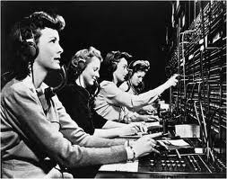

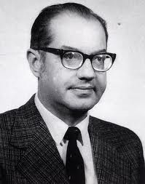
Packet Switching
Old telephone network used channel switching:
Dedicated line end-to-end
Silence = unused capacity
1960s: Packet switching
Shared channels carry mixed data
Ideas of Paul Baran (Rand) & Leonard Kleinrock (MIT)

Slide 8
Packet Switching on the Internet
Hosts linked by connections
Many types of hosts
Many types of connections
Common routing protocol
Observations
Real-time & imperfect: “best effort”
Local decisions, not global coordination
Fault tolerant
Specialization: backbone, routers, gateways, etc.

Slide 9
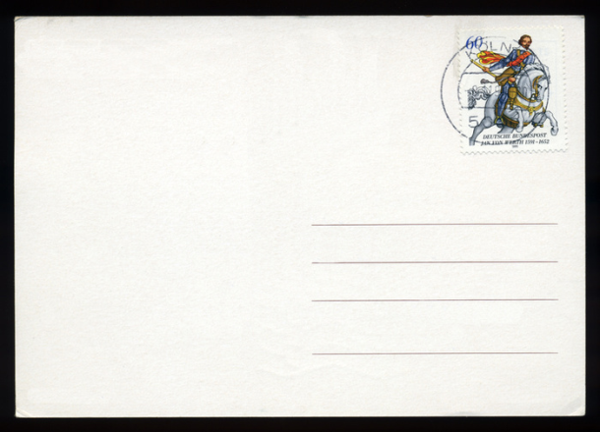
Internet Protocol (IP)
veliteupurusbibendumveleuismodorcipellentesque.Morbiacorciaelitpharetraconvallis.Vestibulum at mi eu odio elementumullamcorpernonecarcu.Aeneannonrisusnisi.Donecquislectusod
Hosts have a unique IP address
Four bytes, like this: 131.229.64.1
Packets specify destination address
Also give time to live (TTL) = max # hops allowed
Routers keep tables of forwarding addresses
Compared with neighbors every ~30 seconds
Unresponsive neighbors dropped from table
Packets may be wrapped in a frame for each hop
(Allows for different local transfer protocols)
To: 131.229.103.27
From: 131.229.64.1
TTL: 24
Address | Forwarding Destination
131.229.X.X | 131.229.64.1
128.119.X.X | 128.119.2.249
148.85.136.X | 148.85.34.9
Routing table:

Slide 10
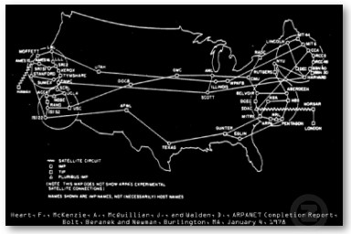
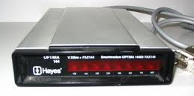
Growth of Internet Infrastructure
1969: DARPAnet built
4 nodes (UCLA, Stanford, UCSB, U. Utah)
First test: L-O-G-
1977: ARPAnet still fits on T-shirt
1980’s: Higher education joins in
1983: Internet protocol standard (replaces NCP)
1986: NSFnet (backbone) runs at 56kbps
1990’s: Commercial enterprises and individuals
Hayes modem (invented 1977)

Slide 11

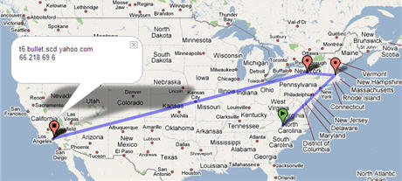
Activities
Ping lab
Traceroute lab

Slide 12
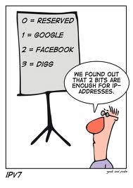
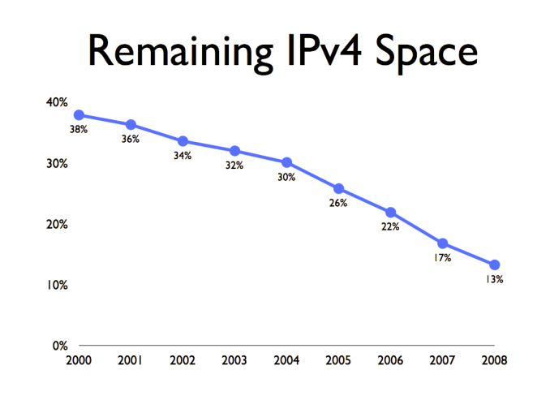
Address Availability
Q. 4 bytes in IP address. How many addresses?
A. 2³² adresses, or about 4 billion
Many allocated & unused (Smith has 65536)
More internet capable devices (e.g., smartphones)
We are running out of IP addresses!
What can be done?
have run

Slide 13
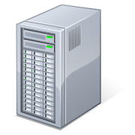

(Partial) Solution #1: DHCP
DHCP = Dynamic Host Configuration Protocol
Each host requests local IP address from a pool
Addresses are “leased” not “owned”
DHCP server hands out
IP addresses from a pool
215.68.17.67
215.68.17.0
Internet
215.68.17.114

Slide 14
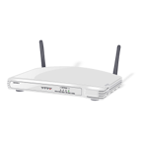
Solution #1: DHCP + NAT
NAT = Network Address Translation
DHCP server has only “real” IP address
Assigns fake addresses in special reserved blocks
Alters addresses on inbound/outbound packets
192.168.1.1
Home routers offer DHCP with NAT
215.68.17.0
(outward facing IP)
192.168.1.0
(inward facing IP)
Internet
192.168.1.2
Notes:
192.168.X.X, 10.X.X.X, 172.16.0.0-172.31.255.255

Slide 15
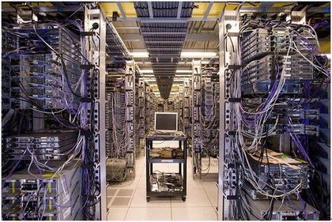
Solution #2: IPv6
New internet protocol uses 6 byte addresses
2⁴⁸ addresses: will we ever run out?
Main problem: how to switch over

